Slide 2
GAS TURBINES
A gas turbine is a combustion engine at the heart of a power plant that can convert natural gas or other liquid fuels to mechanical energy. This energy then drives a generator that produces the electrical energy that moves along power lines to homes and businesses.
By- Ayush Mishra ME III 2210013105011

Slide 3
INTRODUCTION
COMBUSTOR
THE WORKING OF A GAS TURBINE IS BASED ON:
BRANTYON CYCLE
1-2 Isentropic Compression
2-3 Isobaric Heat addition
3-4 Isentropic expansion
4-1 Isobaric Heat rejection
COMPRESSOR
TURBINE
W

Slide 4
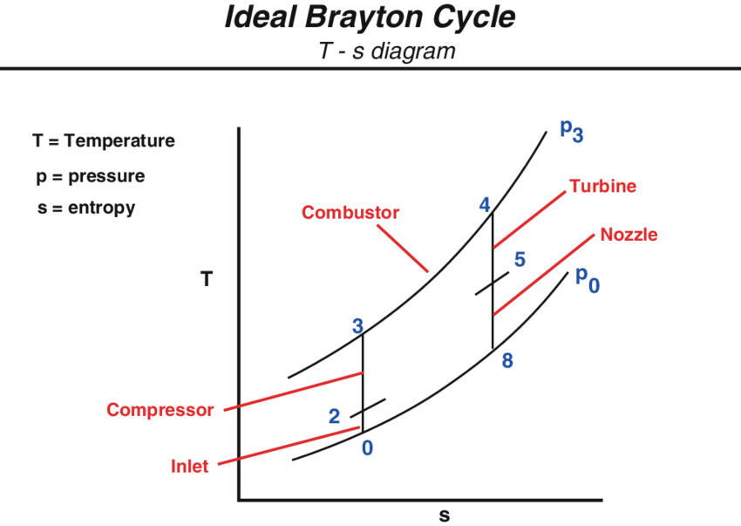
BRAYTON CYCLE

Slide 5
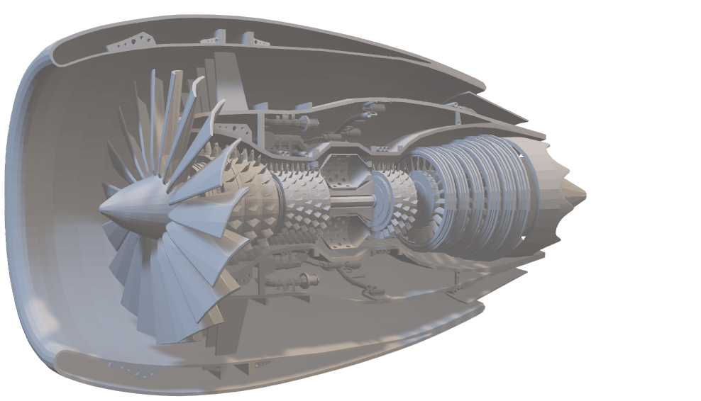
Gas turbine
“A Gas Turbine typically comprises of three”, namely :
COMPRESSOR
COMBUSTOR
TURBINE

Slide 6
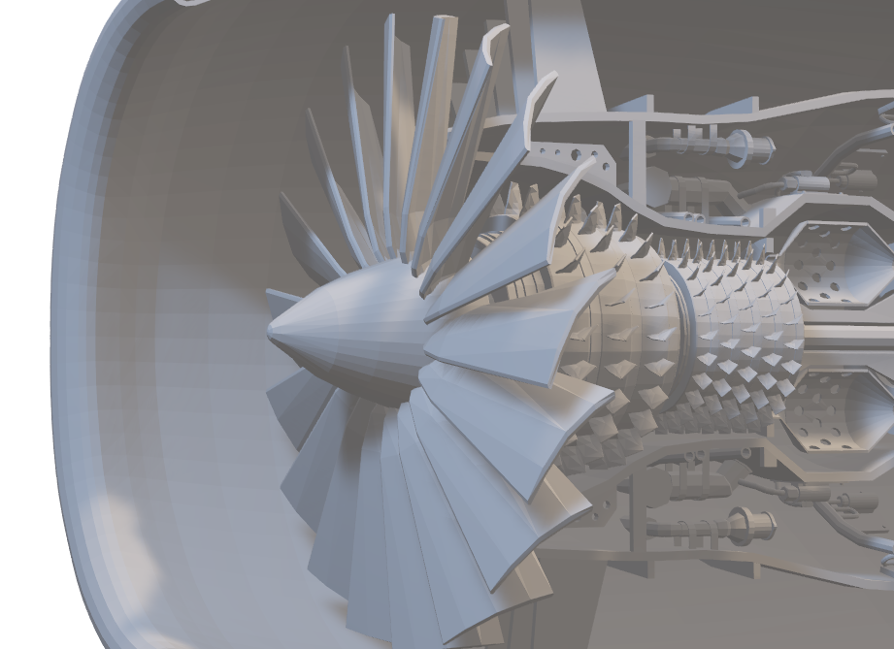
Compressor
“The COMPRESSOR is what takes in air from outside of the turbine and increases its pressure at hundreds of MPH, then feeds it to the combustion chamber.”

Slide 7
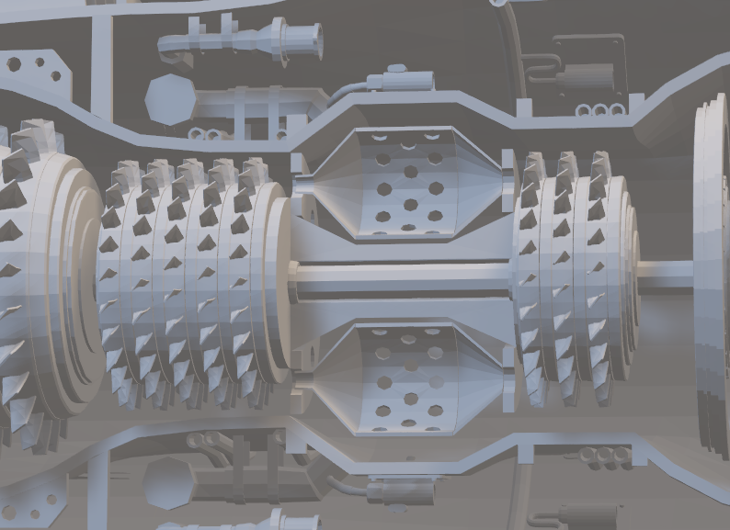
Combustor
“The COMBUSTOR is what actually burns the fuel and produces high-pressure gas. The mixture is burned at temperatures of more than 2,000 °F to expand within the turbine section at high velocity.”

Slide 8
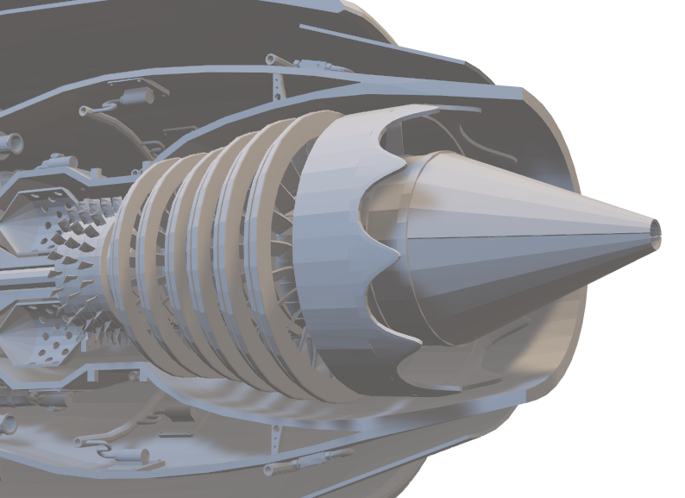
turbine
“The TURBINE extracts the energy from the gas in the combustor. This is done with an array of stationary and rotating airfoil blades. Finally, the new kinetic energy from the blades runs a generator that produces power”

Slide 9
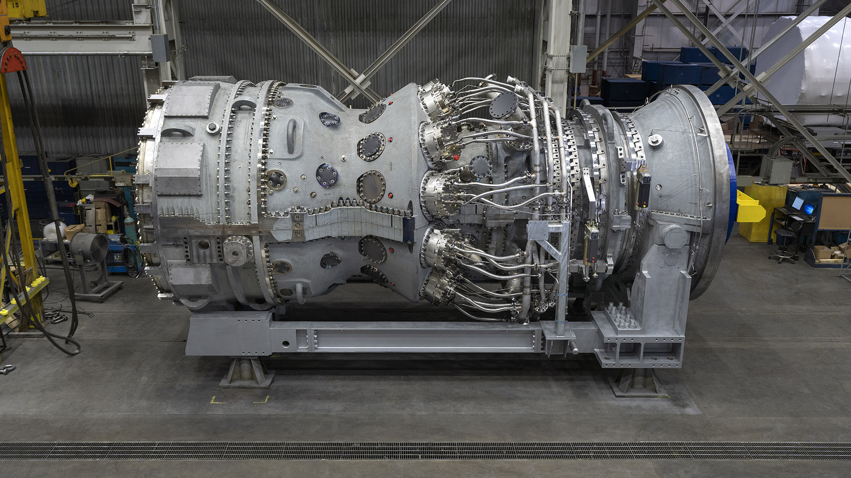
Gas turbine fuels
Gas Turbine typical uses high octane fuels. Care should be taken that the oil fuel should not contain moisture and suspended impurities. The various paraffins used in gas turbine are methane, ethane, propane, octane (gasoline) and dodecane (kerosene oil). Out of these gasoline and kerosene or blend of the two are commonly used.

Slide 10
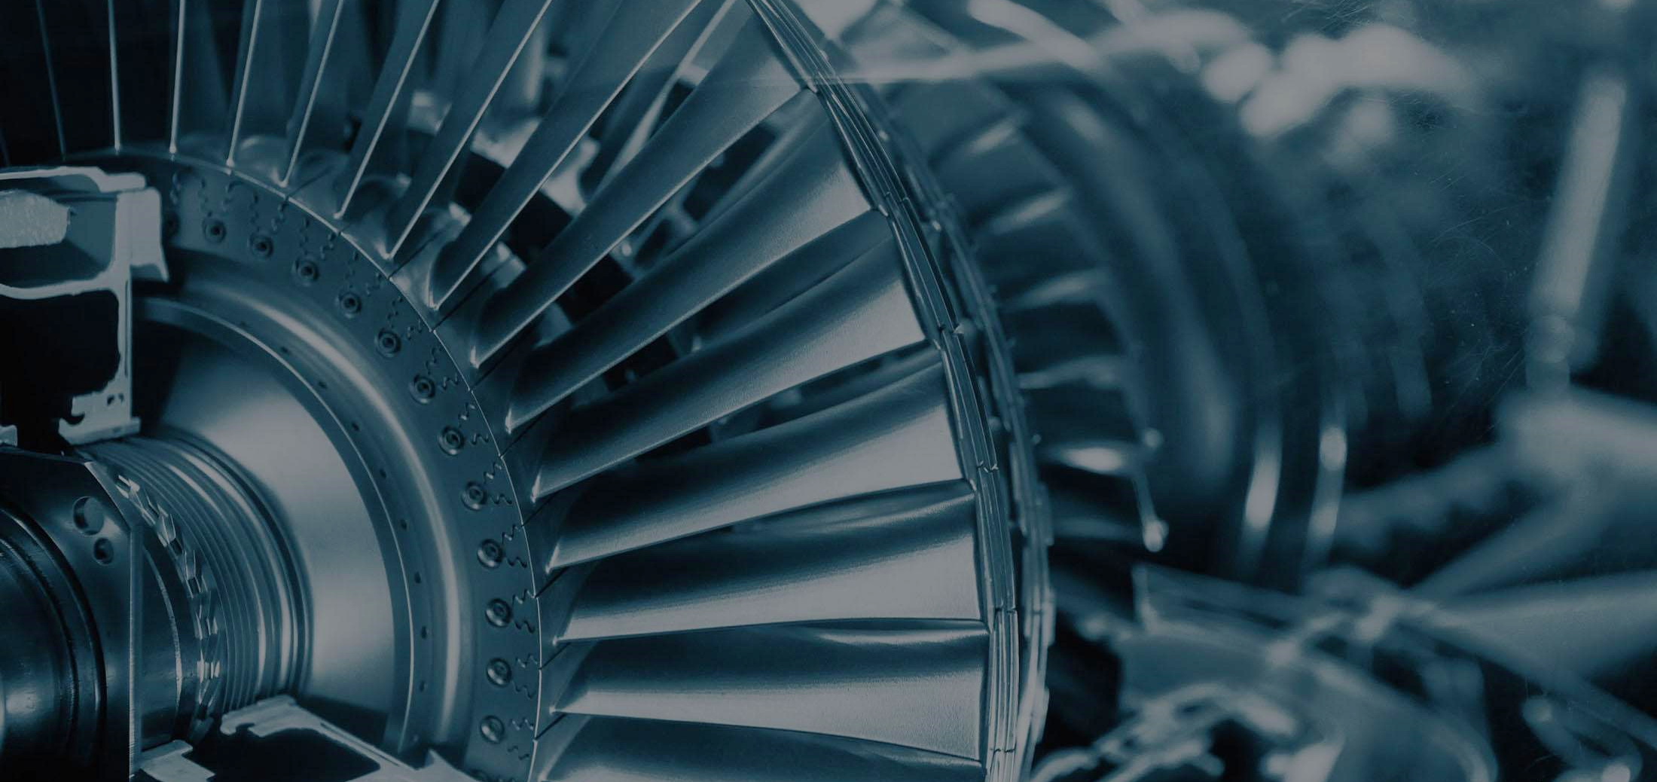
EFFICIENCY OF
A GAS TURBINE

Slide 11
BLADE EFFICIENCY
Isentropic Efficiency
Isentropic efficiency of a turbine is the ratio of the actual work output of the turbine to the work output that would be achieved if the turbine operated under ideal isentropic conditions. It measures how closely the turbine's performance approaches the ideal scenario where no energy is lost.
VS
The energy supplied per stage of an impulse turbine is equal to kinetic energy given by η_{b}=ṁC₂i₂ and assuming that the kinetic energy leaving the stage is wasted.

Slide 12
PROCESS OF INTERCOOLING
Thermodynamic processes involved in multistage inter cooled compression are shown in figure. First stage compression occurs in low pressure compressor (LPC) and compressed air leaving LPC at ‘2’issent to intercooler where temperature of compressed air is lowered down to state 3 at constant pressure. In case of perfect intercooling the temperature after intercooling is brought down to ambient temperature i.e., temperature at 3 and 1 are same. Intercooler is a kind of heat exchanger where heat is picked up from high temperature compressed air.
Q
COMBUSTOR
INTERCOOLER
L.P
COMPRESSOR
H.P COMPRESSOR
TURBINE
W

Slide 13
PROCESS OF REHEATING
Reheating in gas turbines is crucial in enhancing the overall efficiency and performance of these powerful machines. Gas turbines are widely used in various industries, including power generation, aviation, and industrial processes, due to their ability to convert fuel into mechanical energy with remarkable efficiency. However, engineers have developed the concept of reheating to extract even more energy from the combustion process and improve the system's overall efficiency. Reheating in a gas turbine increases thermal efficiency by preventing the temperature drop of exhaust gases, which allows for additional work to be extracted from the expanded gases in subsequent turbine stages.
Q_{in}
Q_{in}
COMBUSTOR 2
COMBUSTOR 1
H.P COMPRESSOR
TURBINE 1
TURBINE 2
W

Slide 14
PROCESS OF Regenerator
The turbine exhaust gas might still contain a significant amount of heat at a higher temperature than the compressor outlet gas (after the last compression stage but before the combustor). For this purpose, a heat exchanger called a regenerator is used. This heat regenerator allows the air exiting the compressor to be preheated before entering the combustion chamber, reducing the amount of fuel that must be burned in the combustor. This form of heat recycling is only possible if the gas turbine is run with a low-pressure ratio.
REGENRATOR
q
COMBUSTOR 1
H.P COMPRESSOR
TURBINE 1
W

Slide 15

Questions?

Slide 16

thank you

